Slide 1


DEPARTMENT OF INFORMATION TECHNOLOGY
V R SIDDHARTHA ENGINEERING COLLEGE
Interpreting Doctors Prescription Using
Deep Learning Techniques
Domain : Health Care
B.Tech in INFORMATION TECHNOLOGY
EPICS Project Review Presentation
Presented by :
RIZWANULLAH MD( 208W1A1299 )
AJAY KUMAR VARMA N ( 208W1A12A1 )
Under the guidance of
DR M SUNEETHA ( HOD IT )

Slide 2
Agenda :
01
Problem Statement
02
Objective’s Of Project
03
Literature Review
04
Datasets and Software Requirements
05
Architecture Diagram
06
Algorithm

Slide 3
Problem Statement
Interpreting Doctors Prescription ,notes using handwriting recognition and Deep Learning techniques
Solution to digitize the handwritten prescriptions which can also help to integrate tightly with other healthcare systems for seamless digitization and data flow.
Standardized forms can also be made machine readable with support for multiple local Indian languages to make digitization much simpler.

Slide 4
OBJECTIVE’S OF PROJECT
Helps people who cant understand doctor's prescription handwriting.
An ordinary individual can know name of the medicine prescribed in prescription.

Slide 5
LITERATURE REVIEW
This Research paper is taken from : https://www.researchgate.net/publication/353488043
Shaira Tabassum :- Has developed Medicine Name Recognition Model by using Bi-Directional Long short term memory (Bi directional LSTM)
Md Moshiur Rahman :- Graduate School of Biomedical and Health Sciences, MBBS, MPH, PhD. Has good knowledge about all medicines and their names and can recognize them on prescription. He helped sharia tabassum in terms of Medicine names and identification and some datasets he provided.

Slide 6
Ashir Ahmed :- He is an IT professional at Kyushu university.He is one team member worked with Shaira and he took some part in completing project.
They opted bangladeshi doctor’s handwritten prescription for their project and they achieved aprox 96% Accuracy on a bangla dataset by using Bi directional lstm and Rss model for data augmentation.

Slide 7
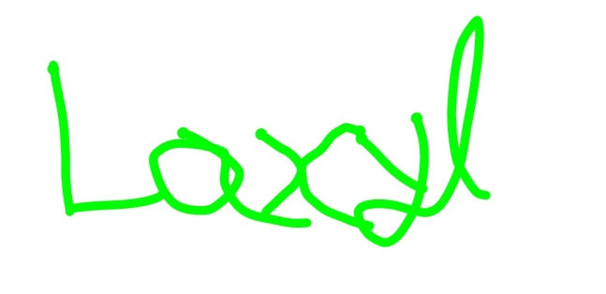
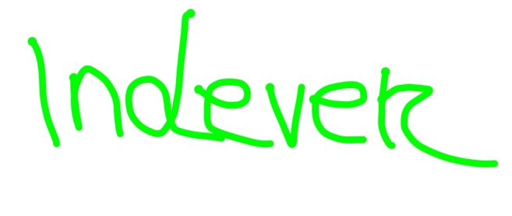
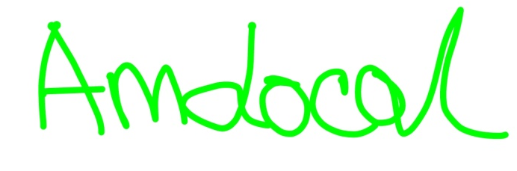
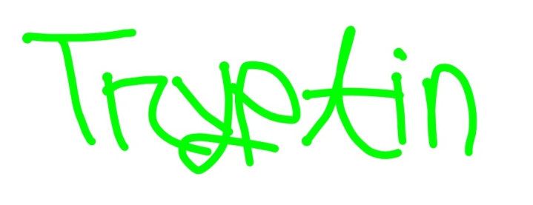
DATASET
Doctors hand writing dataset : https://github.com/rizwanrockzz/epics/tree/main/dataset

Slide 8
SOFTWARE REQUIREMENTS
User Requirements:
Dataset acquired from ieee.org
Input is an image with doctor prescription.
Output is digital text displayed on Screen.
Functional Requirements:
Python Programming Language.
Bi directional LSTM model.
Tensorflow,keras Py Libraries.
System Requirements:
Windows Operating System.
Configuration: RAM 8GB.
Software : VS Code.
Non-Functional Requirements:
Accuracy.
Reliability.

Slide 9
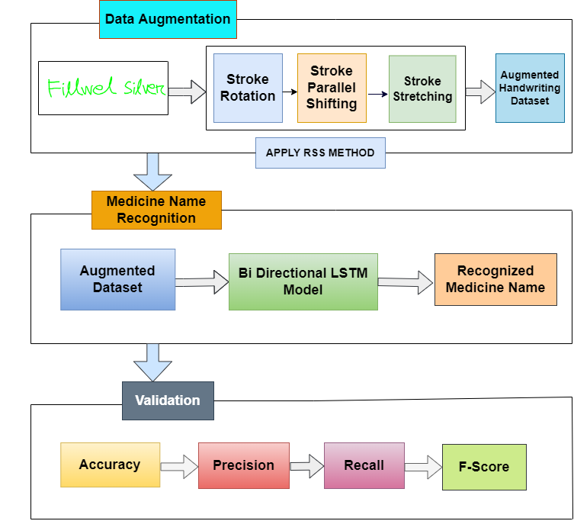
ARCHITECTURE
diagram

Slide 10
ALGORITHM
Bidirectional long-short term memory (BI - LSTM) is the process of making any neural network o have the sequence information in both directions backwards (future to past) or forward (past to future).
In bidirectional, our input flows in two directions, making a BI-LSTM different from the regular LSTM. With the regular LSTM, we can make input flow in one direction, either backwards or forward. However, in bi-directional, we can make the input flow in both directions to preserve the future and the past information.

Slide 11
Steps:
Importing some libraries in python which are well fit for deep learning algorithms like Bi directional LSTM- Numpy, Pandas, Matplotlib ,Keras, Sklearn, Pickle etc..
Cleaning GPU.
Perform data augumentation by Combining, Splitting, Parallel stretching of input image text and Stroke Rotation.
Use Bi-directional LSTM for final text recognition from augmented data

Slide 12
Thank You

